Slide 1

2nd Programming Seminar
2nd Programming Seminar
27.Feb.2015(Wed.)
Matrix Vector Multiplier Algorithm
Korea Univ.
Distributed Supercomputing Lab
석사 1학기 황 두 현

Slide 2
2nd Programming Seminar
CONTENTS
Algorithm
Code
Result

Slide 3


2nd Programming Seminar
1. Algorithm
1. Algorithm
Example
2. Error detection
Dimension error
Metrix column vs vector size
No several data
Previous row vs current row
Column != 0
End matrix?
No
m by n
matrix
n by 1
vector
m by 1
vector
Yes
start
Read a matrix element
1
1
2
3
1
1
Open file
Read a vector element
2
1
$$×$$
$$=$$
x
Multiply each elements
3
1
1
1
Find matrix size
1
+
2
+
3
Making result
( + )
1
Decide sampling rate
No
End vector?
No
Yes
Sampling time?
Yes
Detect error
No Error?
No
finish
Yes
Write element

Slide 4
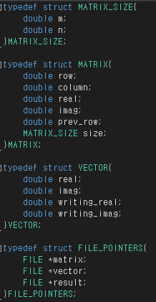
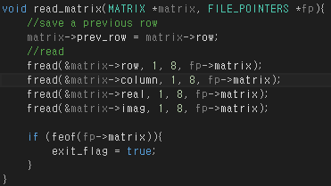
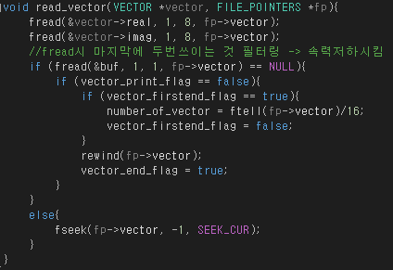
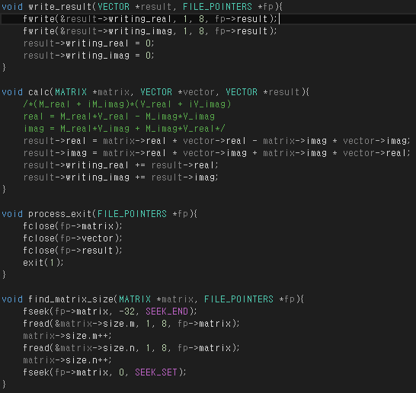
2nd Programming Seminar
2. Code(cont.)
Structures
find_matrix_size()
read matrix & read vector
VECTOR
MATRIX
POINTER

Slide 5
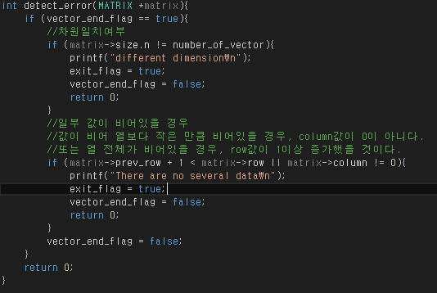
2nd Programming Seminar
2. Code
calculation
Write result
Process exit
Error detection

Slide 6
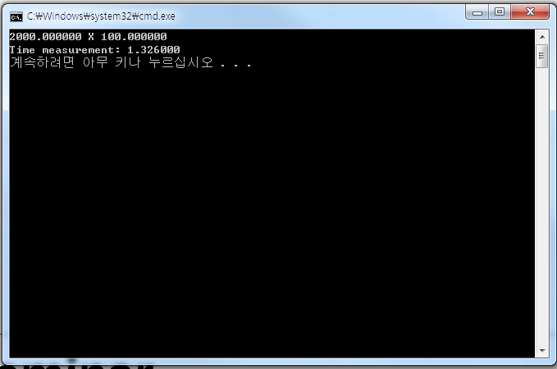
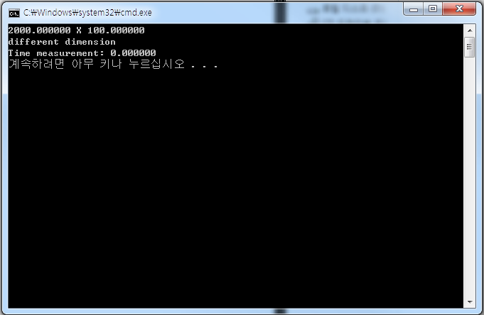
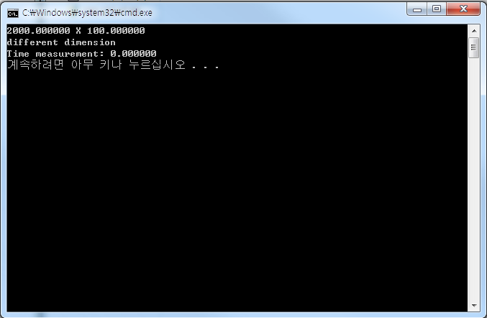
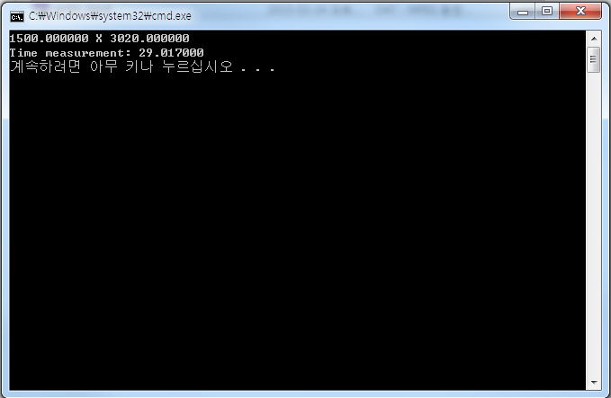
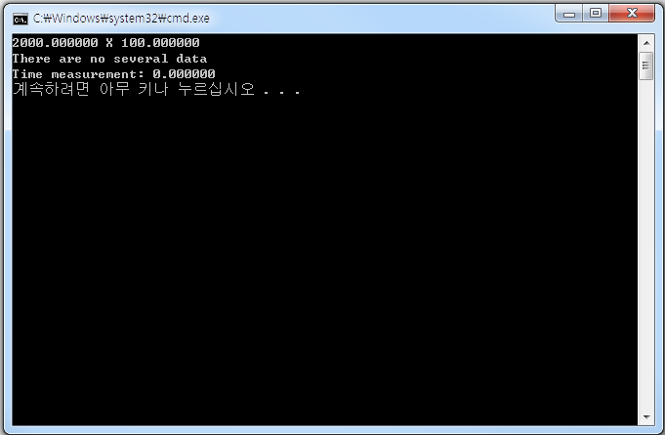
2nd Programming Seminar
3. Result
Good Answer
Wrong Answer1
Wrong Answer2
Wrong Answer3
대용량

Slide 7
THANK YOU & Q&A

